Slide 1
Computer Fundamentals

Slide 2
Today’s Topics
Servers
Databases
Big Data
Clouds

Slide 3

Notes:
Kahoot url: CF Review https://create.kahoot.it/details/a631b609-2c84-4d21-a9fe-cbe5f8ca47f1

Slide 4
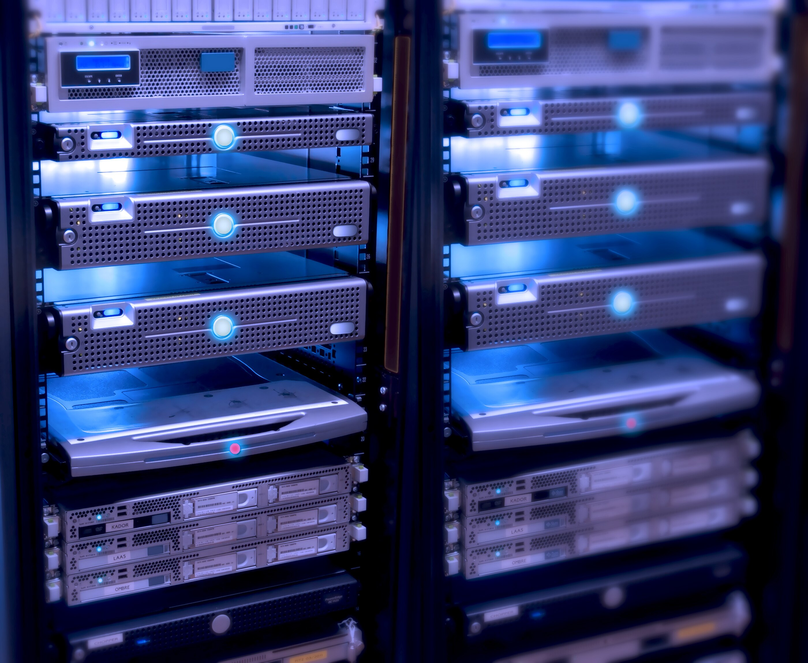
Server
What is Server
Notes:
Servers are computers that provide data to other computers.
Most servers are accessed remotely using remote access software.

Slide 5
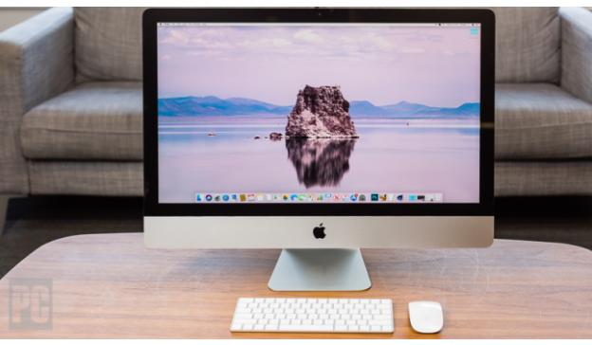


Server
What are the differences?
Notes:
In fact, a regular desktop computer can be turned into a server by adding the appropriate software. For example, a computer connected to a home network can be designated as a file server, print server, or both.

Slide 6
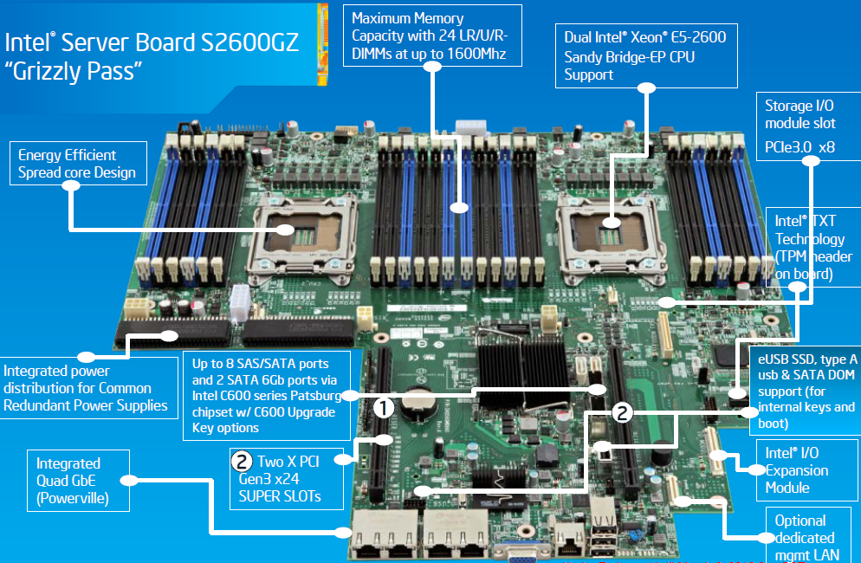
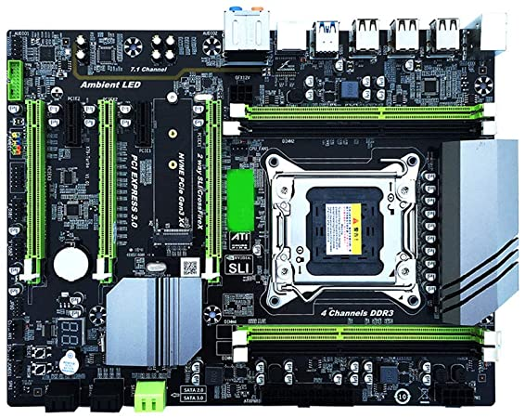
Server
Server Mainboard
PC Mainboard
Notes:
Both the computer and the server have a mainboard.. But as you see on the picture a server’s mainboard is more complex and if you noticed it has two cpu connections.

Slide 7
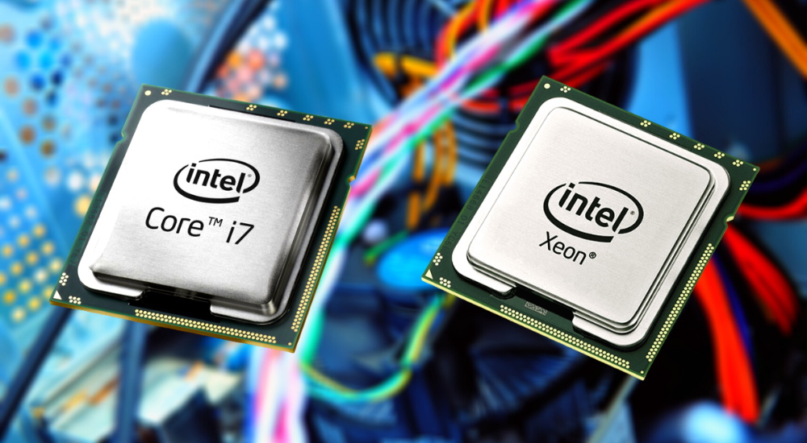
Server
Notes:
The server computer has a much more powerful processor.
The processors have a different form factor

Slide 8
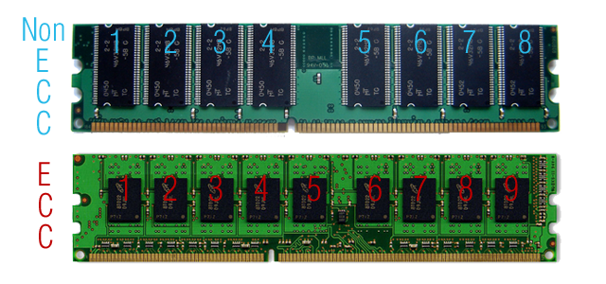
Server
Error-checking and Correcting (ECC)
Notes:
A server computer’s RAM is more sophisticated than a pc. It has error checking and correcting feature.
ECC ram corrects memory corruption due to random bit flips, preventing system crashes and data corruption. This is important when you cannot afford system failures when using the computer 24/7 for an extended period.

Slide 9
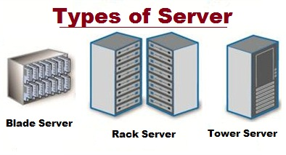
Server
Notes:
These are server types according to their racks.

Slide 10
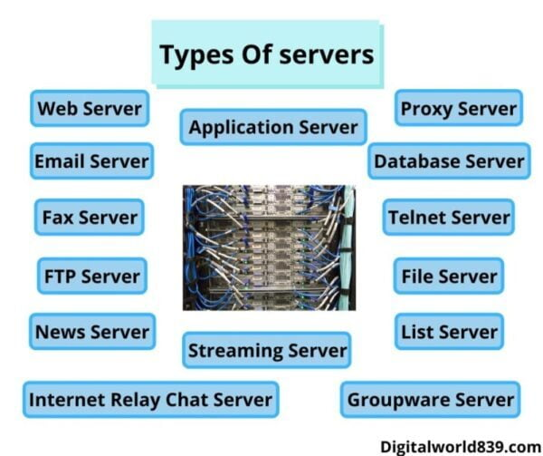
Server
Notes:
Many types of servers exist:
Web Servers,
Mail Servers,
File Servers

Slide 11

Server
High internet connectivity
Air conditioning
Backup electrical power
Fire protection
Security
Maintenance
Notes:
In most cases, server computers are located in data centers. this data centers must have these conditions:
High internet connectivity
Air conditioning
Backup electrical power
Fire protection
Security
Maintenance

Slide 12
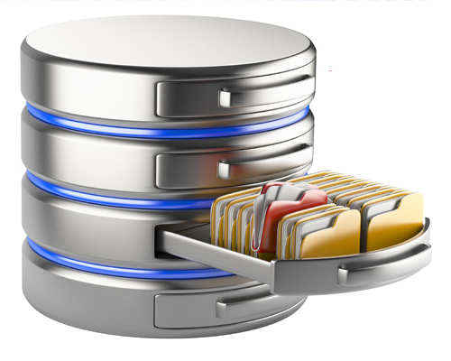
Databases
Databases are collections of data, usually organized under a schema, and stored in a format that is efficient for storing and retrieving the data.
Notes:
One strength of computers is their ability to store and process information
Information is stored in databases
Usually can't "see" all the data - choose certain columns at a time, or filter out rows with certain features
Basic Idea: companies store a lot of information, then responses involve searching the saved information based on the request

Slide 13
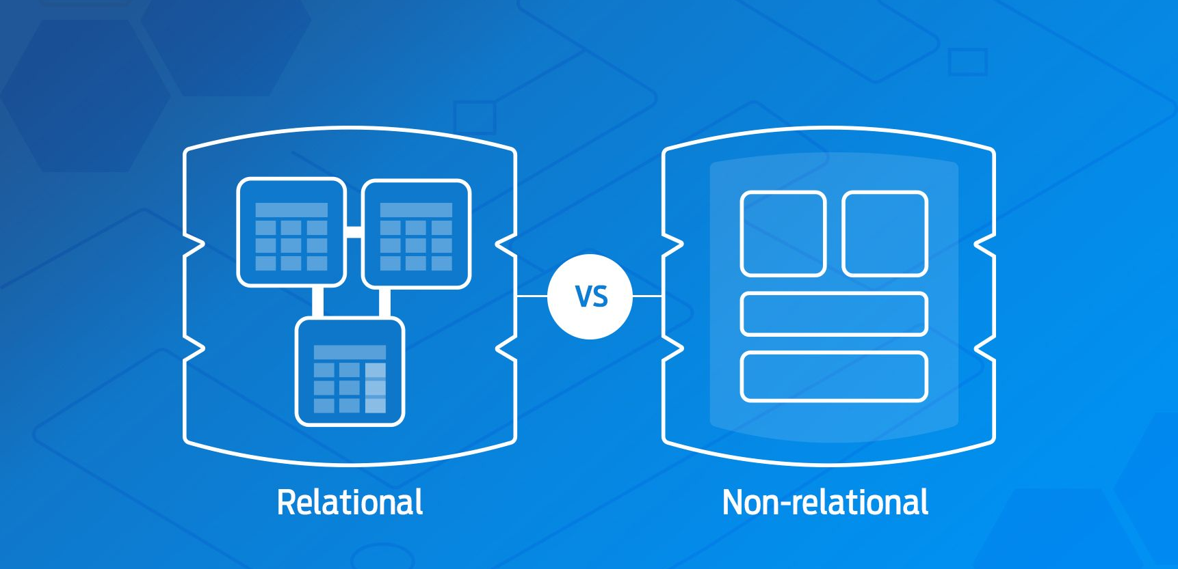
Databases
Types of Databases
Notes:
There are two types of databases: Relational and Non-relational.

Slide 14
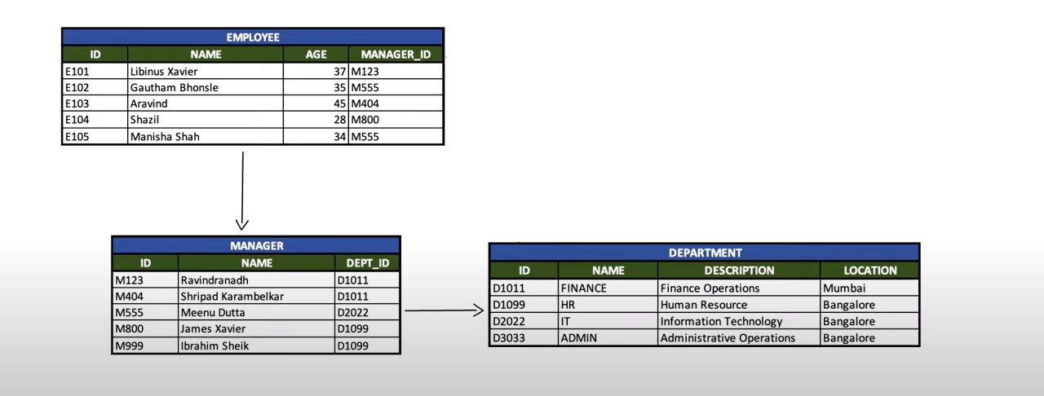
Databases
Relational Database (SQL)
Notes:
SQL databases are classic databases and are what we default to talking about when we teach databases.
SQL databases define and manipulate data based on structured query language (SQL)
SQL databases are table-based
Great support is available for all SQL databases from their vendors. Also, a lot of independent consultations are there who can help you with SQL database for a very large scale deployments

Slide 15
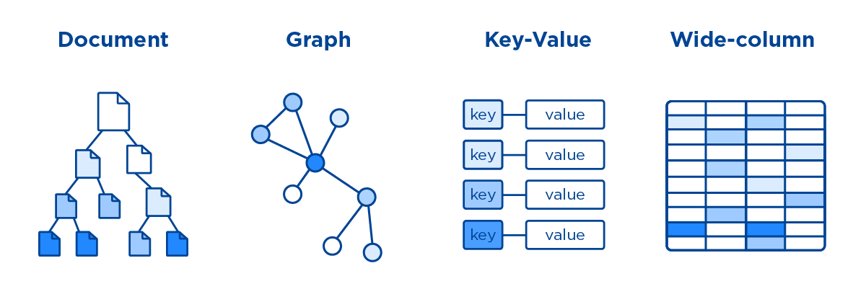
Databases
Non-Relational Database (NoSQL-Not Only SQL)
Notes:
A NoSQL database has a dynamic schema for unstructured data.
NoSQL databases are either key-value pairs, document-based, graph databases or wide-column stores.
NoSQL databases can also offer more flexibility in storage options, allowing one to spread data across many machines more easily than SQL databases tend to do.
In NoSQL database you have to rely on community support and only limited outside experts are available for setting up and deploying your large scale NoSQL deployments.

Slide 16
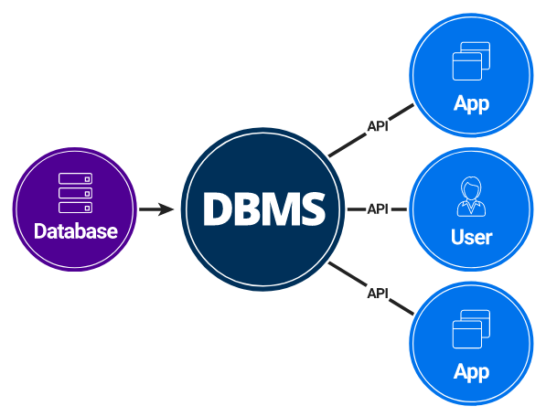
Databases
Database Management System (DBMS)
Notes:
When people talk about databases they tend to talk about the underlying Database Management System (DBMS). These are programs like MySQL or PostgreSQL which are designed to complete the tasks of storing, retrieving, updating, caching, deleting, and other data manipulation.

Slide 17
Databases
Database Management System (DBMS)
Creates the complex structures required for data storage.
Transforms entered data to conform to the data structures.
Creates a security system and enforces security within that system.
Allow multiple user access to the data within the computer network environment.
Performs backup and data recovery procedures to ensure data safety.
Promotes and enforces integrity rules to maintain data consistency.
Provides access to the data via utility programs and from programming languages interfaces.

Slide 18
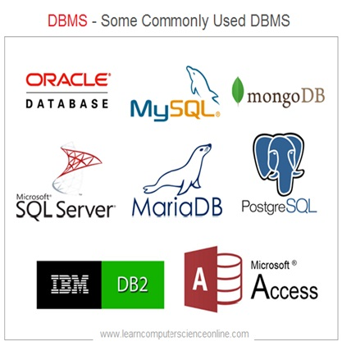
Databases
Database Management System (DBMS)
MySQL
Microsoft Access
Oracle
PostgreSQL
dBASE
FoxPro
SQLite
IBM DB2
LibreOffice Base
MariaDB
Microsoft SQL Server
Notes:
These are the most popular DBMS.

Slide 19
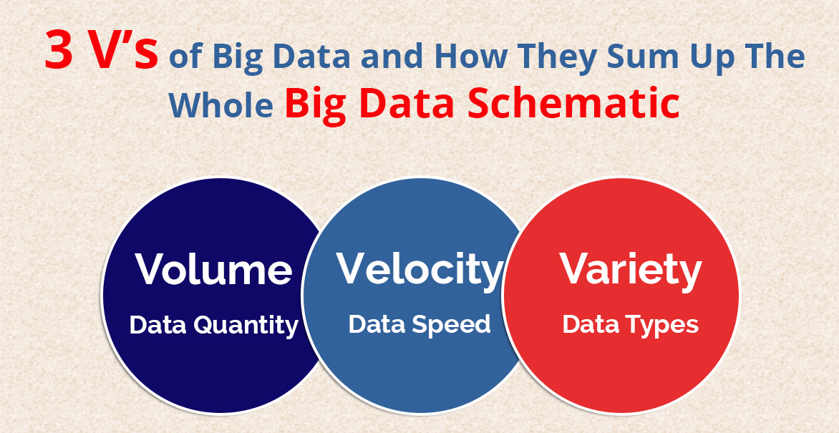
Big Data
Notes:
Big data is data that contains greater variety arriving in increasing volumes and with ever-higher velocity. This is known as the three Vs. Put simply, big data is larger, more complex data sets, especially from new data sources. These data sets are so voluminous that traditional data processing software just can’t manage them. But these massive volumes of data can be used to address business problems you wouldn’t have been able to tackle before.

Slide 20
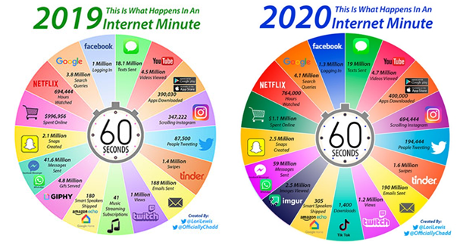
Big Data
Notes:
The picture shows the amount of data that emerged in every one minute in 2019.

Slide 21
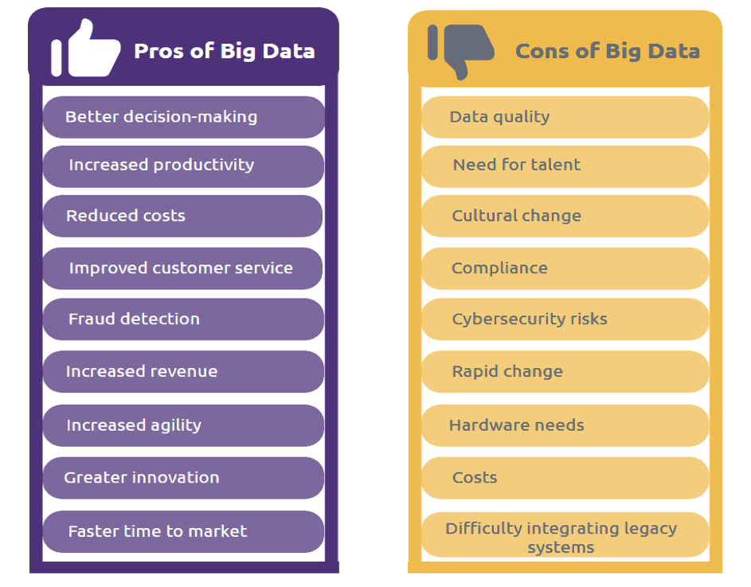
Big Data
Notes:
These are the pros and cons of Big Data.

Slide 22
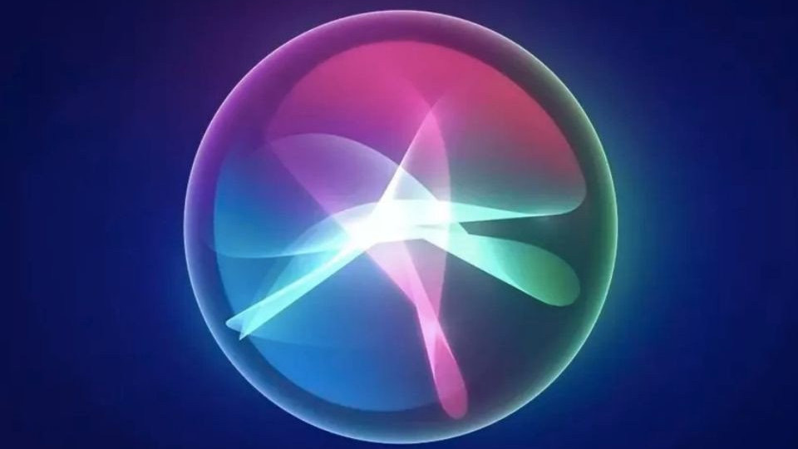
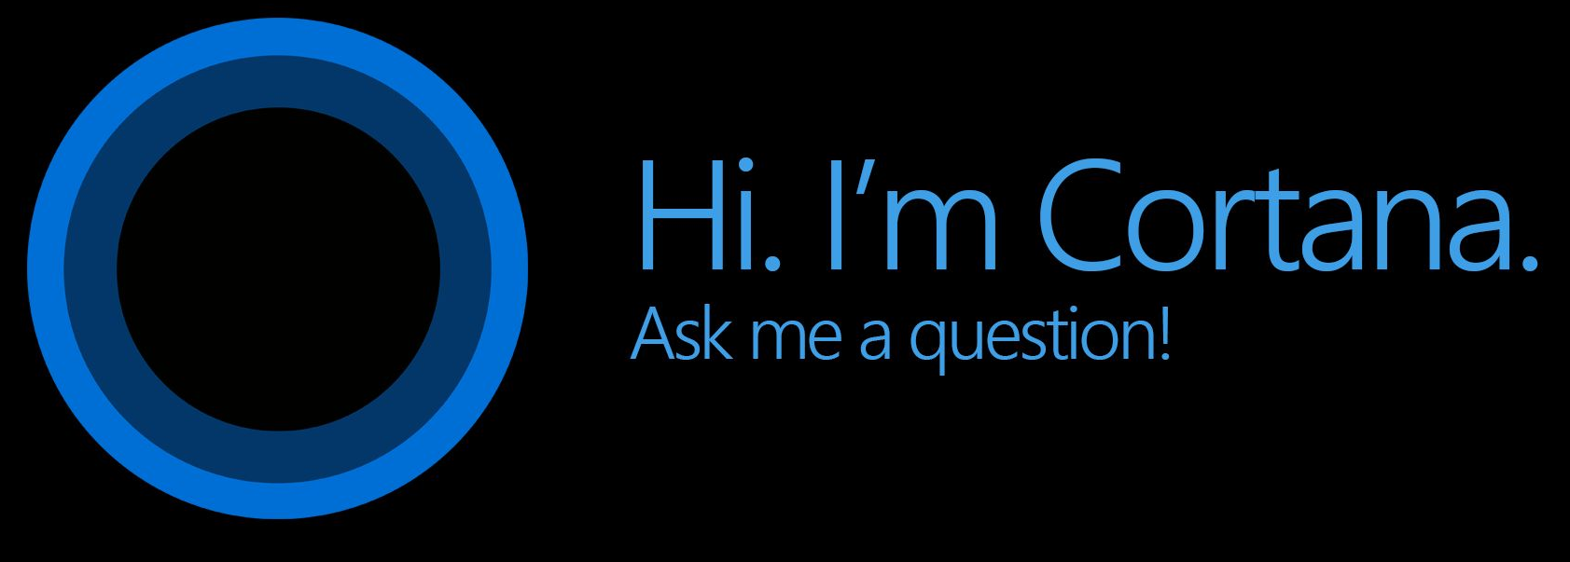
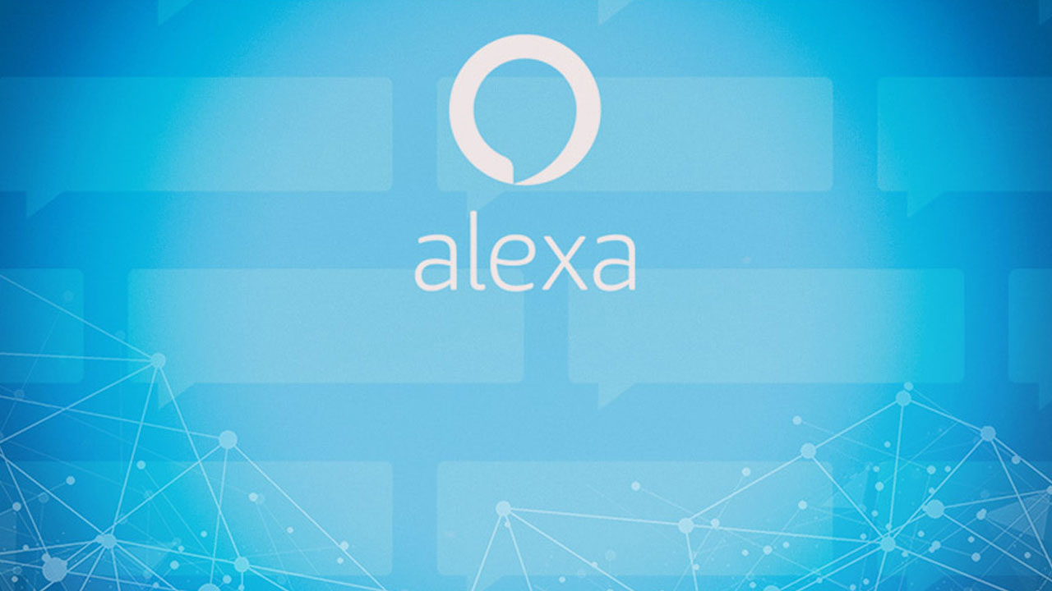
Big Data
My wife asked me why I was speaking so softly at home.
I told her I was afraid Mark Zuckerberg was listening!
She laughed. I laughed.
Alexa laughed. Siri laughed. Cortana laughed.

Slide 23

Please write your ideas about Big Data
Notes:
Summarize
Have students write a quick, 1-2 sentence summary of the information they’ve just learned.
🍐 This is a Pear Deck Text Slide
🍐 To edit the type of question, go back to the "Ask Students a Question" in the Pear Deck sidebar.

Slide 24
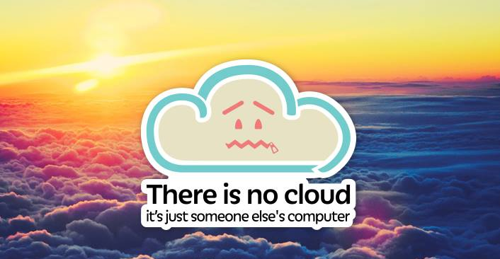
Clouds
Notes:
This is a classic and popular joke. There is no cloud it’s just someone else’s computer.

Slide 25
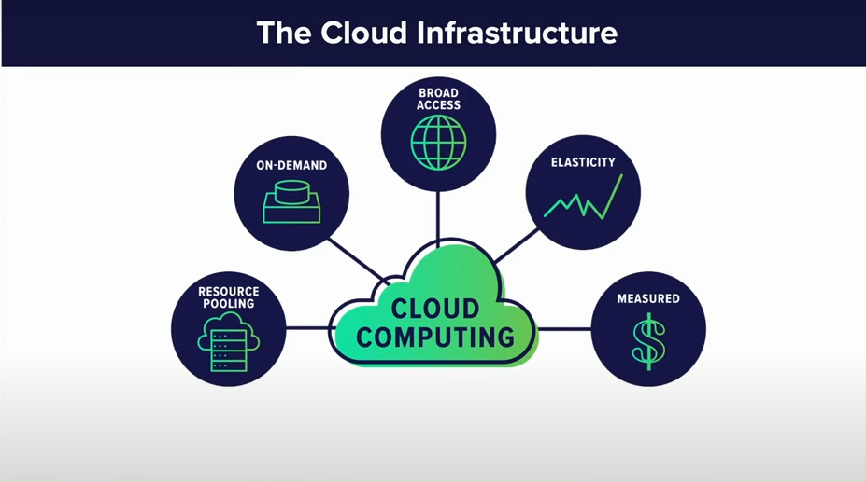
Clouds
Notes:
There are five features of the cloud infrastructure:
1- Resource pooling
2- On-demand
3- Broad access
4- Elasticity
5- Measured

Slide 26
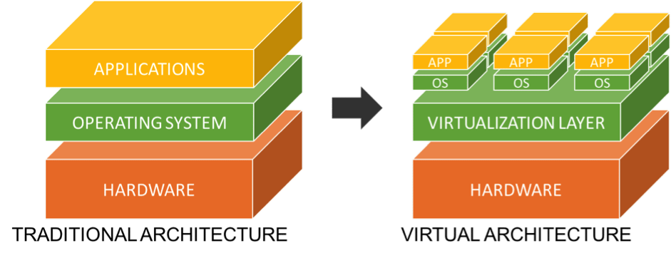
Clouds
Virtualization
Notes:
Cloud computing is possible because of a technology called virtualization. Virtualization allows for the creation of a simulated, digital-only virtual computer/machine that behaves as if it were a physical computer with its own hardware.

Slide 27

Clouds
Notes:
The cloud refers to servers that are accessed over the Internet and the software and databases that run on those servers. Cloud servers are located in data centers all over the world. By using cloud computing, users and companies don't have to manage physical servers themselves or run software applications on their own machines.

Slide 28
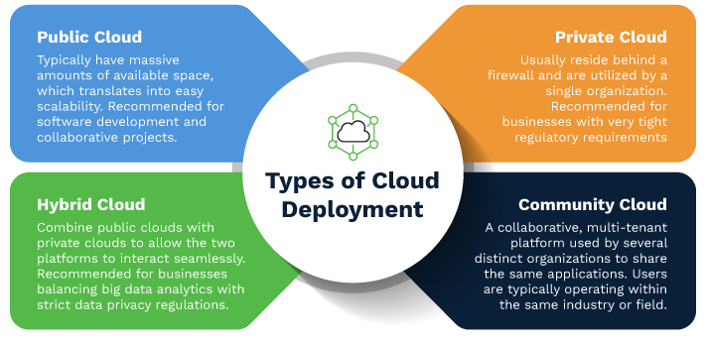
Clouds
Notes:
There are four types of cloud deployment.
1- Private cloud: a single company or organization's cloud, Facebook
2- Public cloud: AWS, Azure, Google cloud, Pinterest
3- Hybrid cloud: for example database on private cloud and webserver on public cloud, Walmart
4- Community cloud: a private cloud shared with two or more companies or organizations, usually a shared business sector, i.e., government, educational institutions

Slide 29
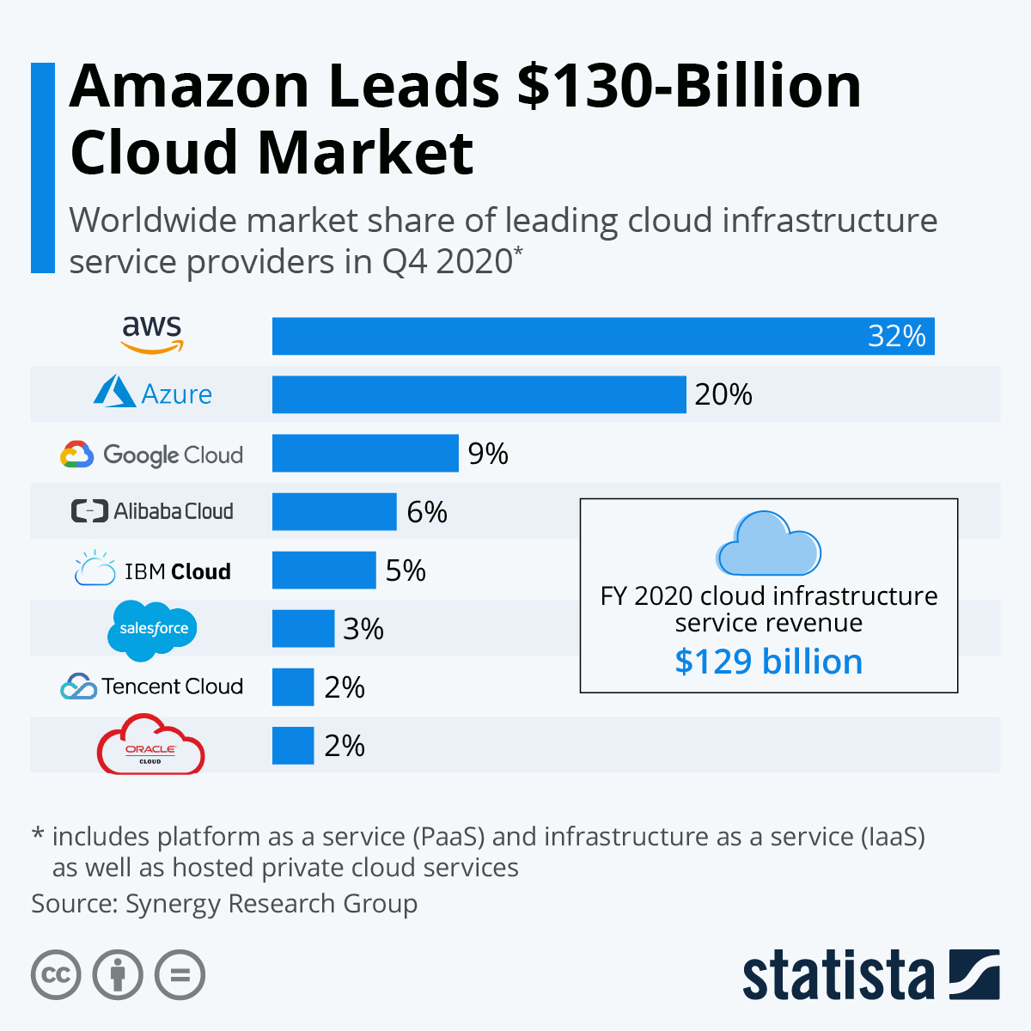
Clouds
Notes:
Worldwide market share of leading cloud service providers is shown on the picture.

Slide 30
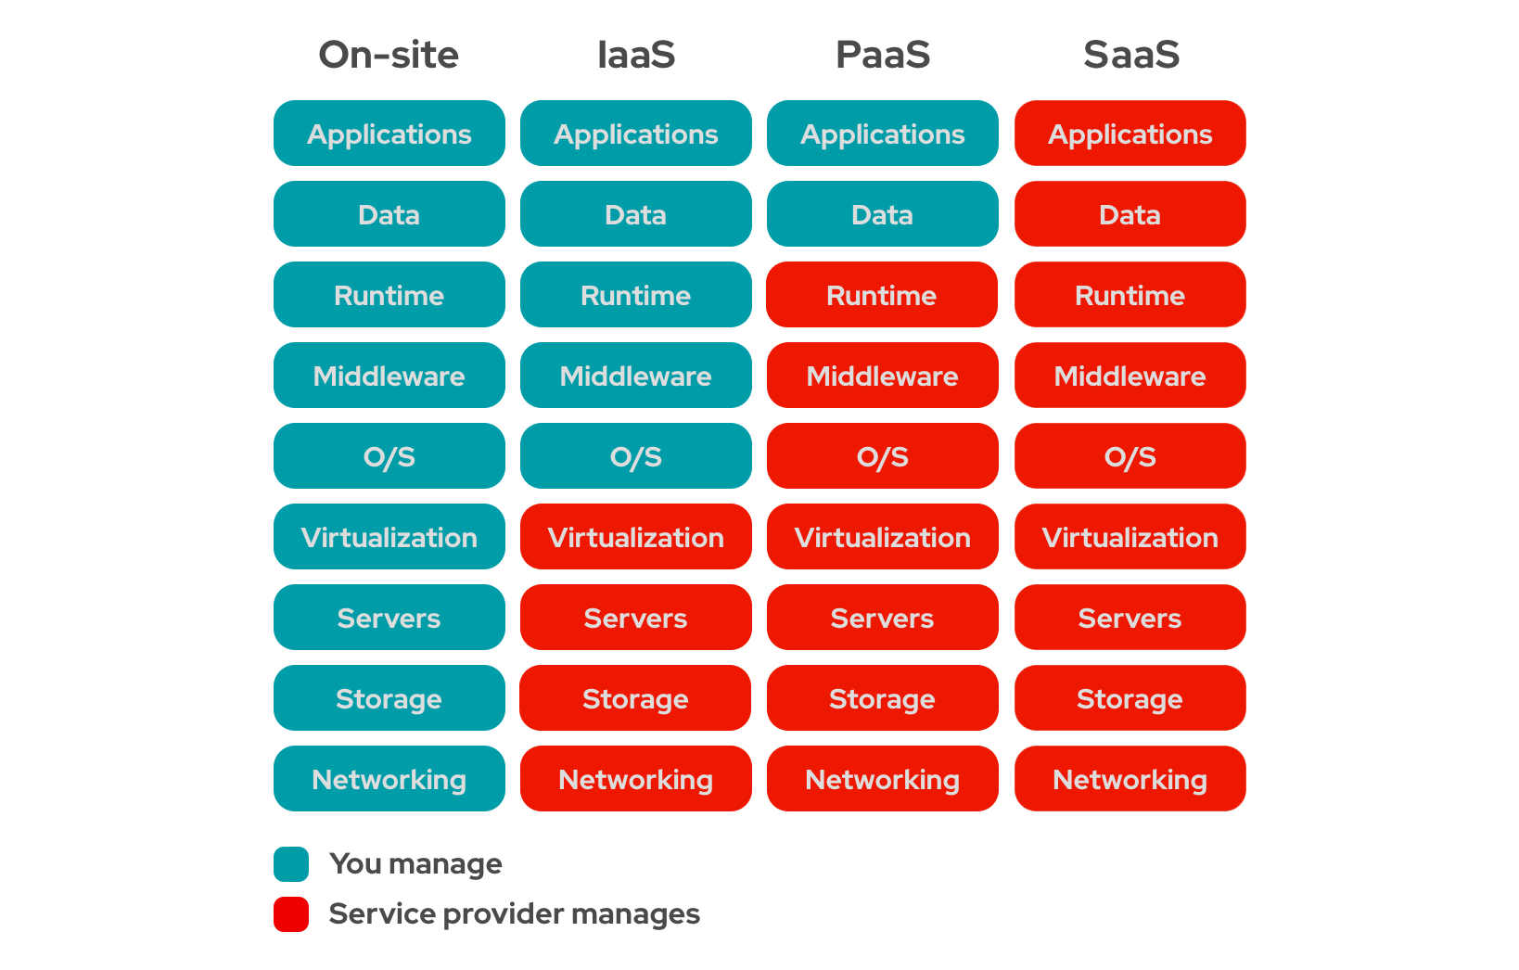
Clouds
Notes:
Infrastructure-as-a-Service (IaaS): In this model, a company rents the servers and storage they need from a cloud provider. They then use that cloud infrastructure to build their applications.
Platform-as-a-Service (PaaS): In this model, companies don't pay for hosted applications; instead they pay for the things they need to build their own applications. PaaS vendors offer everything necessary for building an application, including development tools, infrastructure, and operating systems, over the Internet. PaaS can be compared to renting all the tools and equipment necessary for building a house, instead of renting the house itself.
Software-as-a-Service (SaaS): Instead of users installing an application on their device, SaaS applications are hosted on cloud servers, and users access them over the Internet. SaaS is like renting a house: the landlord maintains the house, but the tenant mostly gets to use it as if they owned it.

Slide 31
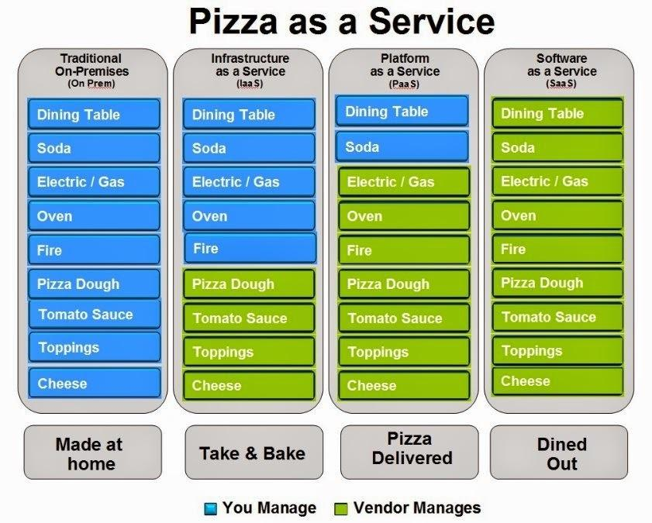
Clouds
Notes:
this is a very popular analogy for service models of cloud computing.

Slide 32


Circle how you are feeling:
Notes:
Emotion Check
Use this template to prompt students to check in with themselves. This will also help you gauge the mood in your classroom and notice any students who might attention.
🍐 This is a Pear Deck Drawing Slide
🍐 To edit the type of question, go back to the "Ask Students a Question" in the Pear Deck sidebar.

Slide 33
Web Browsers
Security

Slide 34
Agenda
Web Browsers
HTTP
Cyber Attacks
Encryption/Decryption
HTTPS
VPN
API

Slide 35
Notes:
https://create.kahoot.it/details/cf-inclass-3-review/48207c4a-cf7c-4a12-a4c4-d4a675e355ff

Slide 36
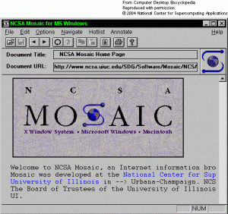
Web Browsers
Notes:
This is the first web browser MOSAIC. It is released in 1994.

Slide 37
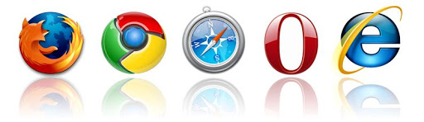
Web Browsers
Notes:
These are the most popular web browsers. Internet Explorer became Edge Browser later. Nowadays google chrome continues to lead the market.

Slide 38
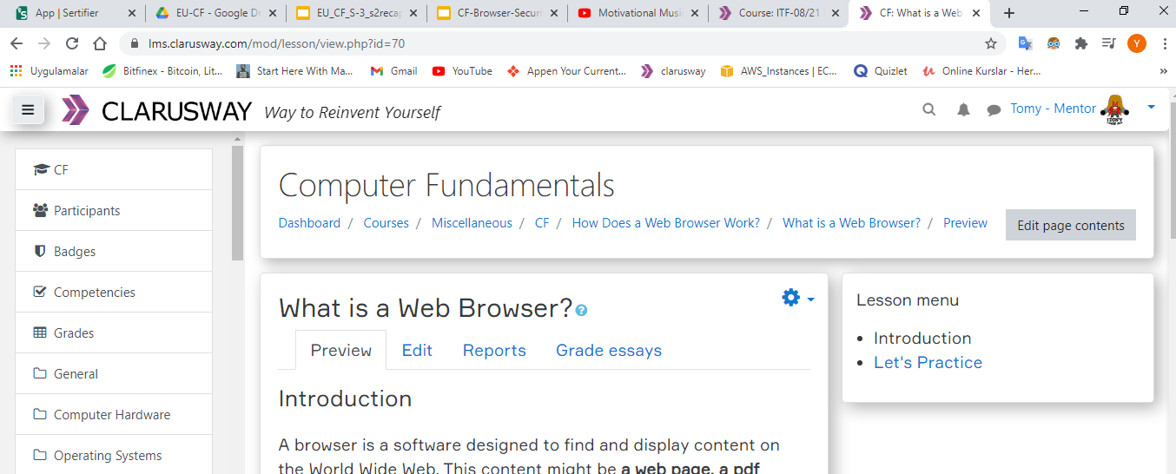
Web Browsers
Notes:
This is a modern web browser. As you noticed there are lots of options like tabs, shortcuts, extensions.

Slide 39


Which web browser do you use?
Notes:
While you are talking with foreign, you should obey language rules. This rules are protocols

Slide 40
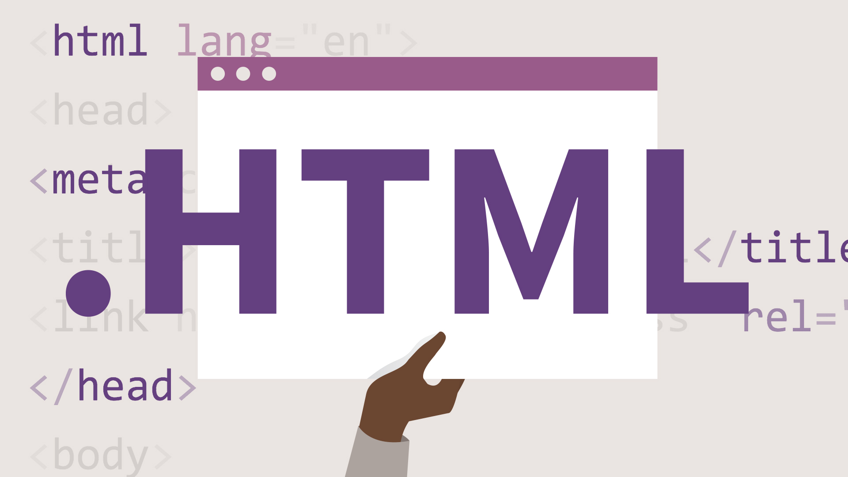
Web Browsers
HTML: Hypertext Markup Language
Notes:
HTML is the standard markup language for Web pages. With HTML you can create your Websites. It is easy to learn.

Slide 41
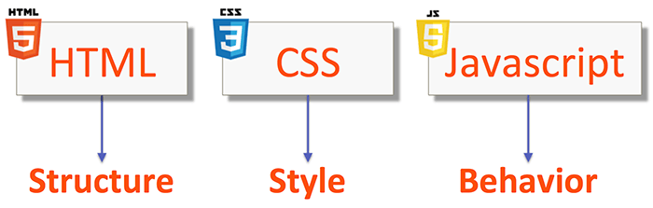
Web Browsers
CSS: Cascading Style Sheets
Notes:
Only html is not enough for a satisfying webpages. You need some other tools like css and javascript. If you wanna stylize your web page
you must use CSS. And for dynamism you can use JS. pay attention for that it is not same language java and javascript.

Slide 42
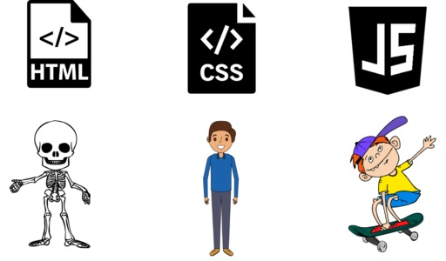
Web Browsers
Notes:
this is an analogy for these three tools. html only makes the structure. and with css and js you can make up your web page.

Slide 43
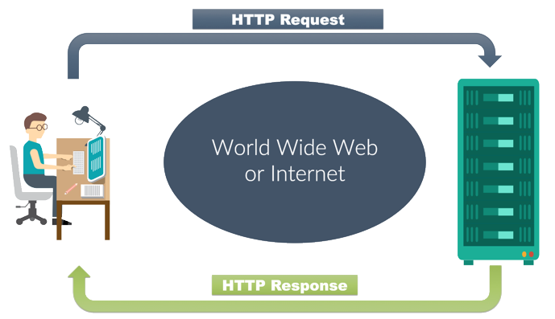
HTTP
HTTP: Hypertext Transfer Protocol
Notes:
The Hypertext Transfer Protocol (HTTP) is an application layer protocol for distributed, collaborative, hypermedia information systems.HTTP is the foundation of data communication for the World Wide Web, where hypertext documents include hyperlinks to other resources that the user can easily access, for example by a mouse click or by tapping the screen in a web browser.

Slide 44
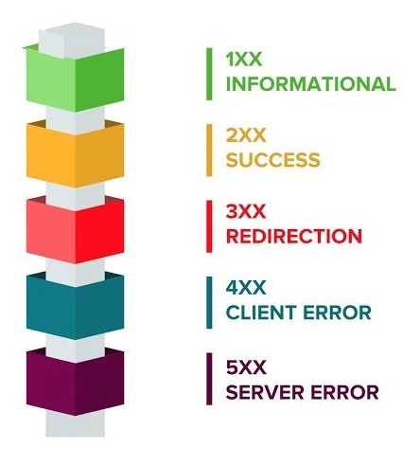
HTTP
HTTP Request
HTTP Response
GET
header
POST
header + body
method
DELETE
PUT
header + body(html, xml, text, json)
Notes:
As a client by using this protocol you make a request to a web server with specific methods like GET, POST, DELETE, PUT. Every request has two parts. The header and the body. But GET method do not has a body, because it is just a request for web page from server. And server response with a status code. 1xx means information, 2xx means success, 3xx means redirection, 4xx means client error, 5xx means server error. After this status code, it sends response consists of header and body.

Slide 45

HTTP
Cookies
Notes:
An HTTP cookie (also called web cookie, Internet cookie, browser cookie, or simply cookie) is a small piece of data stored on the user's computer by the web browser while browsing a website. Cookies were designed to be a reliable mechanism for websites to remember stateful information (such as items added in the shopping cart in an online store) or to record the user's browsing activity (including clicking particular buttons, logging in, or recording which pages were visited in the past). They can also be used to remember pieces of information that the user previously entered into form fields, such as names, addresses, passwords, and payment card numbers.

Slide 46

Cyber Attacks
Physical Security: Using physical barriers to prevent unauthorized access to data (like locking the door of the server room).
Software Security: Fixing flaws in your application that could grant attackers unwanted levels of access to your systems.
Network Security: Security of networked services (websites, databases, etc).

Slide 47
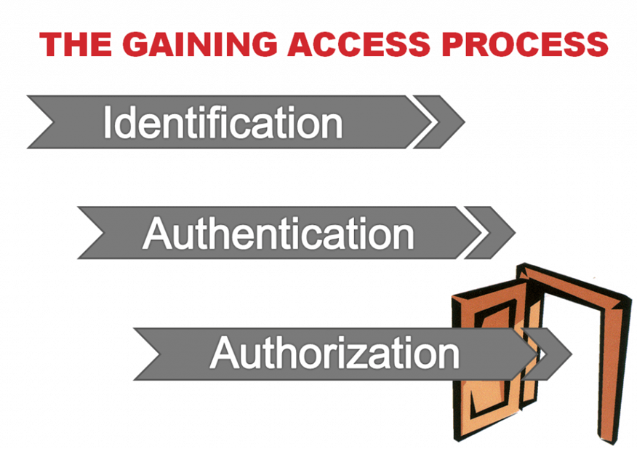
Cyber Attacks
Notes:
Identification: Who is this person?
Authentication: Is this the person who he claims to be?
Authorization: Is this person allowed to perform this action?

Slide 48

Cyber Attacks
Phishing
Notes:
Phishing is the fraudulent attempt to obtain sensitive information or data, such as usernames, passwords and credit card details or other sensitive details, by impersonating oneself as a trustworthy entity in a digital communication. Typically carried out by email spoofing, instant messaging, and text messaging, phishing often directs users to enter personal information at a fake website which matches the look and feel of the legitimate site.

Slide 49
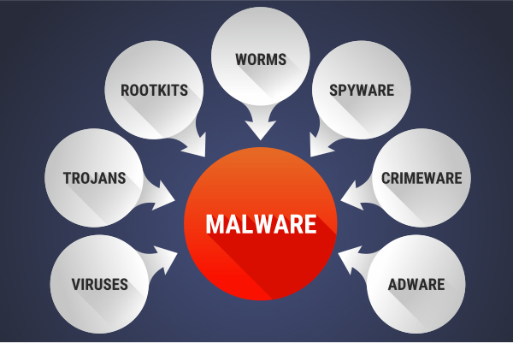
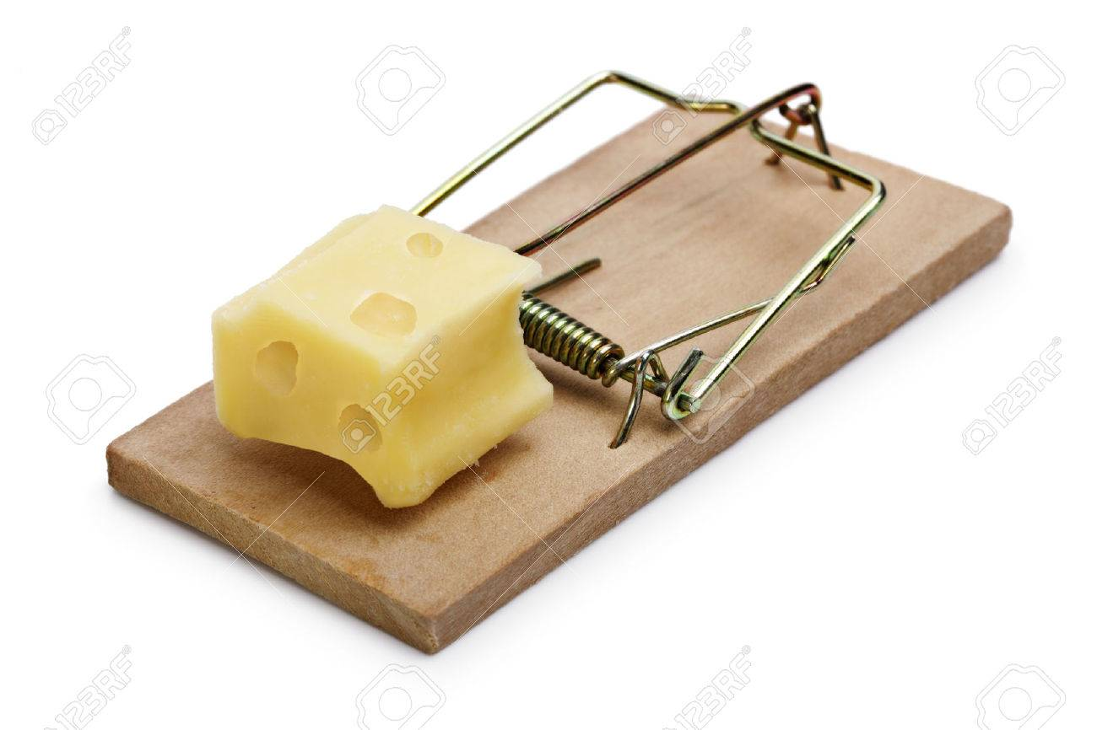
Cyber Attacks
Malware: Malicious Software
Notes:
Malware (malicious software) is any software intentionally designed to cause damage to a computer, server, client, or computer network. Programs are also considered malware if they secretly act against the interests of the computer user. Widely used malwares are viruses, trojans, rootkits, worms, spyware, crimeware and adware. I strongly advise you do not open mails if you don’t know who send it. Don't be fooled by very tempting offers. Do not forget if the range is close and the cheese is big; be sure that it is a trap.

Slide 50
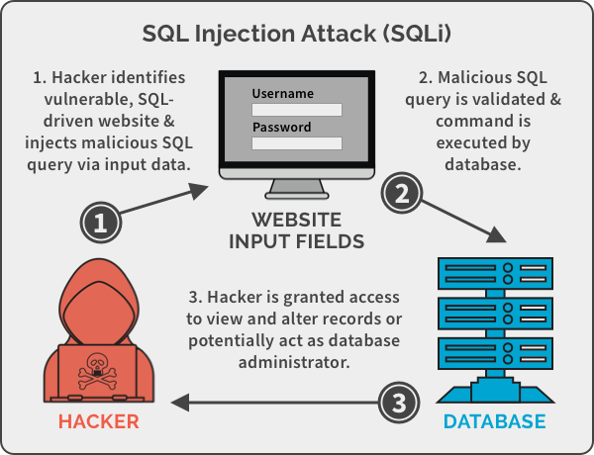
Cyber Attacks
SQL Injection
Notes:
SQL injection is a code injection technique, used to attack data-driven applications, in which malicious SQL statements are inserted into an entry field for execution (e.g. to dump the database contents to the attacker). SQL injection must exploit a security vulnerability in an application's software, for example, when user input is either incorrectly filtered for string literal escape characters embedded in SQL statements or user input is not strongly typed and unexpectedly executed. SQL injection is mostly known as an attack vector for websites but can be used to attack any type of SQL database. SQL injection attacks allow attackers to spoof identity, tamper with existing data, cause repudiation issues such as voiding transactions or changing balances, allow the complete disclosure of all data on the system, destroy the data or make it otherwise unavailable, and become administrators of the database server.

Slide 51
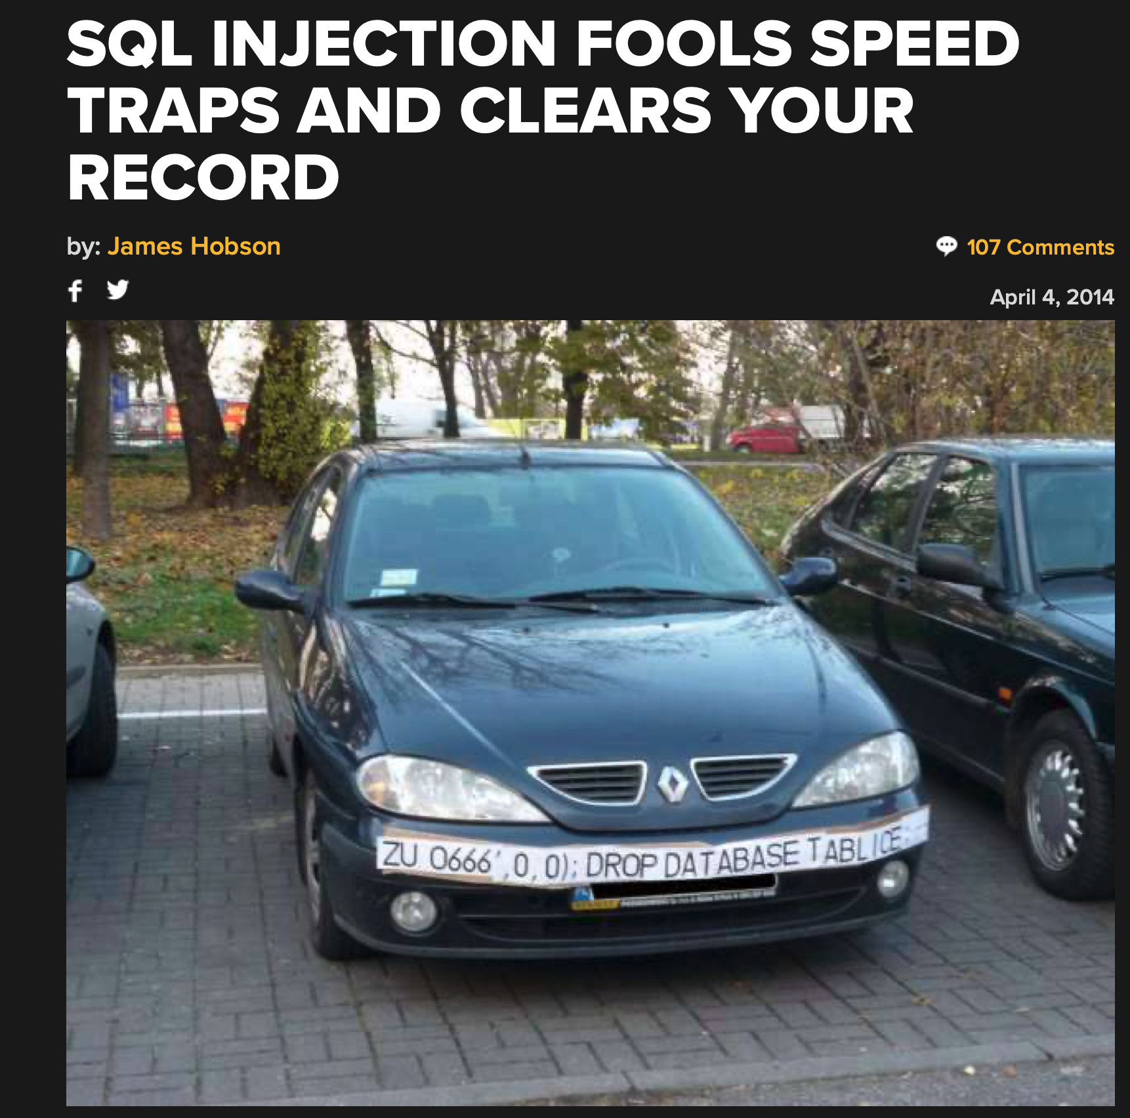
Cyber Attacks
SQL Injection
Notes:
this is a funny sql injection example.

Slide 52
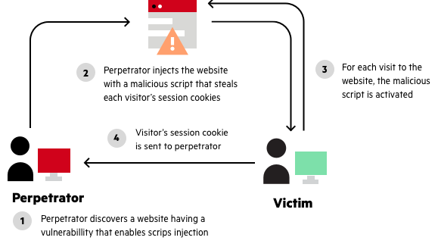
Cyber Attacks
XSS: Cross-Site Scripting
Notes:
Cross-site scripting (XSS) is a type of security vulnerability typically found in web applications. XSS attacks enable attackers to inject client-side scripts into web pages viewed by other users. A cross-site scripting vulnerability may be used by attackers to bypass access controls such as the same-origin policy.

Slide 53
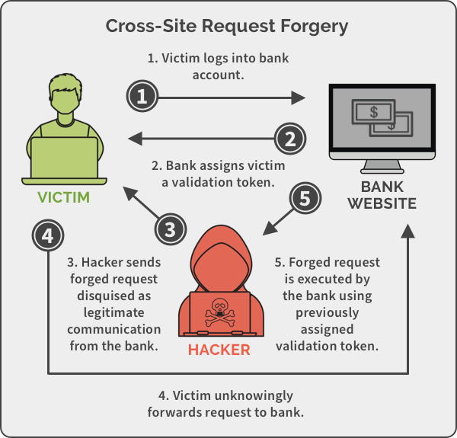
Cyber Attacks
CSRF: Cross-site Request Forgery
Notes:
Cross-site request forgery, also known as one-click attack or session riding and abbreviated as CSRF (sometimes pronounced sea-surf) or XSRF, is a type of malicious exploit of a website where unauthorized commands are submitted from a user that the web application trusts. There are many ways in which a malicious website can transmit such commands; specially-crafted image tags, hidden forms, and JavaScript XMLHttpRequests, for example, can all work without the user's interaction or even knowledge. Unlike cross-site scripting (XSS), which exploits the trust a user has for a particular site, CSRF exploits the trust that a site has in a user's browser. In a CSRF attack, an innocent end user is tricked by an attacker into submitting a web request that they did not intend. This may cause actions to be performed on the website that can include inadvertent client or server data leakage, change of session state, or manipulation of an end user's account.

Slide 54
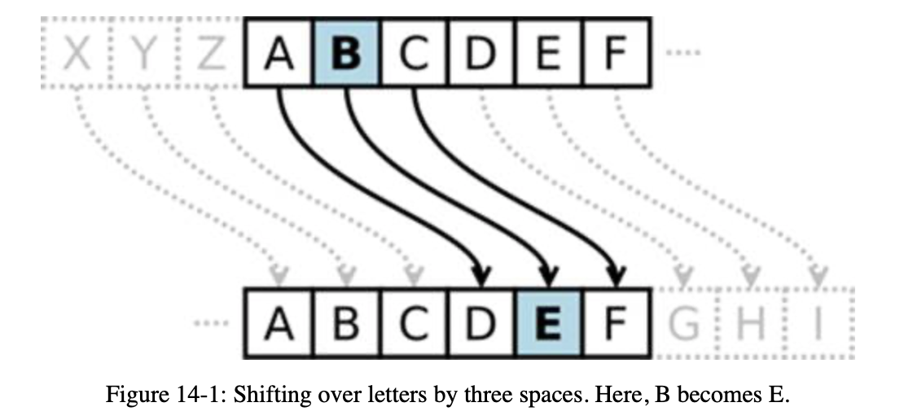
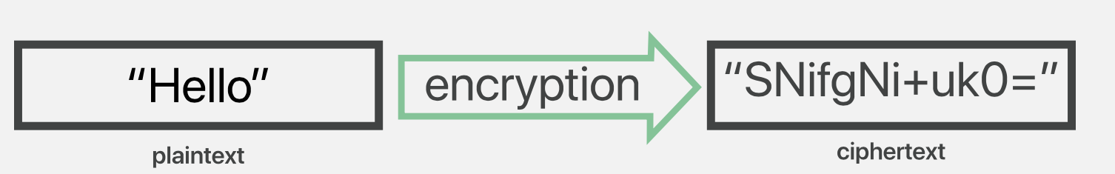
Encryption/Decryption
Notes:
Encryption is a way of scrambling data so that only authorized parties can understand the information. In technical terms, it is the process of converting plaintext (the original bytes (text, image, etc.)) to ciphertext (encrypted text). In simpler terms, encryption takes readable data and alters it so that it appears random. Encryption requires the use of an encryption key that is a set of mathematical values known only by the sender and the recipient of the encrypted message know.

Slide 55
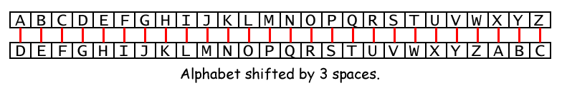
Encryption/Decryption
John → Caesar Cypher +3
Mrkq
Notes:
this is an example of encryption.

Slide 56
Encryption/Decryption
Mike → Caesar Cypher -3
Notes:
🍐 This is a Pear Deck Text Slide
🍐 To edit the type of question, go back to the "Ask Students a Question" in the Pear Deck sidebar.

Slide 57
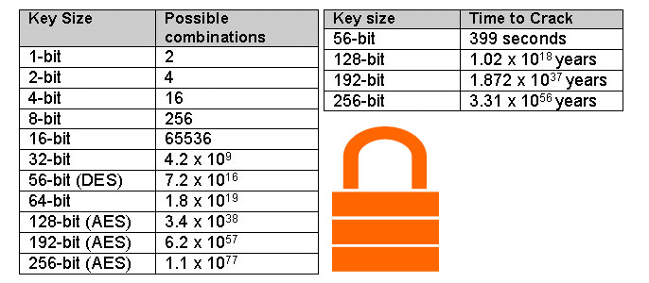
Encryption/Decryption
Notes:
These are the possible combinations of keys according their size and the time to crack.

Slide 58
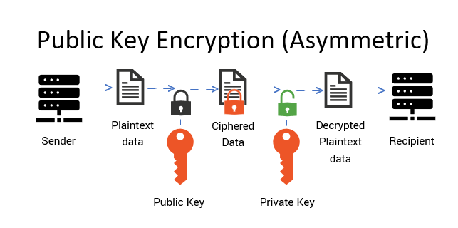
Encryption/Decryption
Notes:
It is a cryptographic system which uses pairs of keys: public keys (which may be known to others), and private keys (which may never be known by any except the owner). The generation of such key pairs depends on cryptographic algorithms which are based on mathematical problems termed one-way functions. Effective security requires keeping the private key private; the public key can be openly distributed without compromising security.

Slide 59
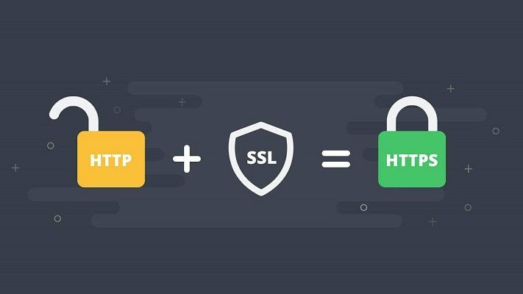
HTTPS
Popular Certificates and HTTPS:
SSL : Secure Sockets Layer
TLS : Transport Layer Security
Notes:
Hypertext Transfer Protocol Secure (HTTPS) is an extension of the Hypertext Transfer Protocol (HTTP). It is used for secure communication over a computer network, and is widely used on the Internet. In HTTPS, the communication protocol is encrypted using Transport Layer Security (TLS) or, formerly, Secure Sockets Layer (SSL). The protocol is therefore also referred to as HTTP over TLS, or HTTP over SSL.

Slide 60
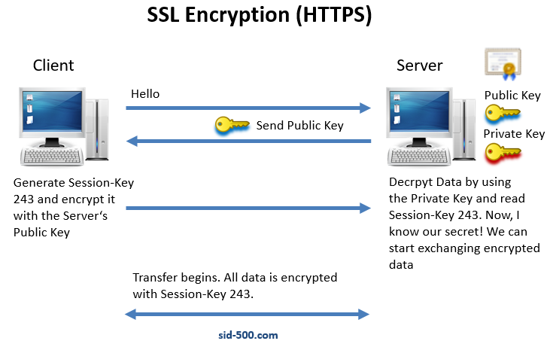
HTTPS

Slide 61
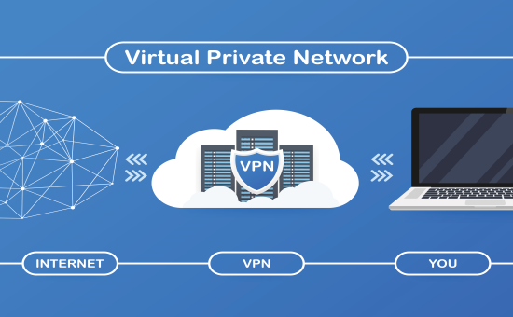
VPN
VPN: Virtual Private Network
Notes:
A virtual private network (VPN) provides privacy, anonymity and security to users by creating a private network connection across a public network connection.

Slide 62

VPN
Notes:
without vpn connection your identity can be traced on servers and also on internet. also your location can be detected.

Slide 63

VPN
Notes:
You can hide your identity and location with vpn.

Slide 64

API
API: Application Programming Interface
Notes:
An application programming interface (API) is a computing interface that defines interactions between multiple software or mixed hardware-software intermediaries. It defines the kinds of calls or requests that can be made, how to make them, the data formats that should be used, the conventions to follow, etc. It can also provide extension mechanisms so that users can extend existing functionality in various ways and to varying degrees. An API can be entirely custom, specific to a component, or designed based on an industry-standard to ensure interoperability. Through information hiding, APIs enable modular programming, allowing users to use the interface independently of the implementation.

Slide 65

API
Notes:
It can also provide extension mechanisms so that users can extend existing functionality in various ways and to varying degrees. An API can be entirely custom, specific to a component, or designed based on an industry-standard to ensure interoperability. Through information hiding, APIs enable modular programming, allowing users to use the interface independently of the implementation.

Slide 66

Notes:
https://create.kahoot.it/details/cf-6-servers-and-clouds/0cd3880c-11ab-4477-9dcc-d3a18726756a

Slide 67
Select how you are feeling on the right:
😎 😀 😐 😕 😞
Notes:
🍐 This is a Pear Deck Multiple Choice Slide. Your current options are: A: 😎, B: 😃, C: 😐, D: 😕, E: 😞,
🍐 To edit the type of question or choices, go back to the "Ask Students a Question" in the Pear Deck sidebar.
Emotion Check
Use this template to prompt students to check in with themselves. This will also help you gauge the mood in your classroom and notice any students who might attention.

Slide 68

In one or two minutes, write the most important thing from today’s lesson.
Notes:
Takeaway
Use this template to help students articulate and retain their biggest takeaways from the day.
🍐 This is a Pear Deck Text Slide
🍐 To edit the type of question, go back to the "Ask Students a Question" in the Pear Deck sidebar.

Slide 69

THANKS!
Any questions?
You can find me at:
@Jamil
jamil@clarusway.com
@Tomy
tomy@clarusway.com

